Slide 1
Text Editor Tricks for Blue Teamers

Slide 2
whoami

Slide 3


Slide 4
Soggy, dirty, cold, tired

Slide 5
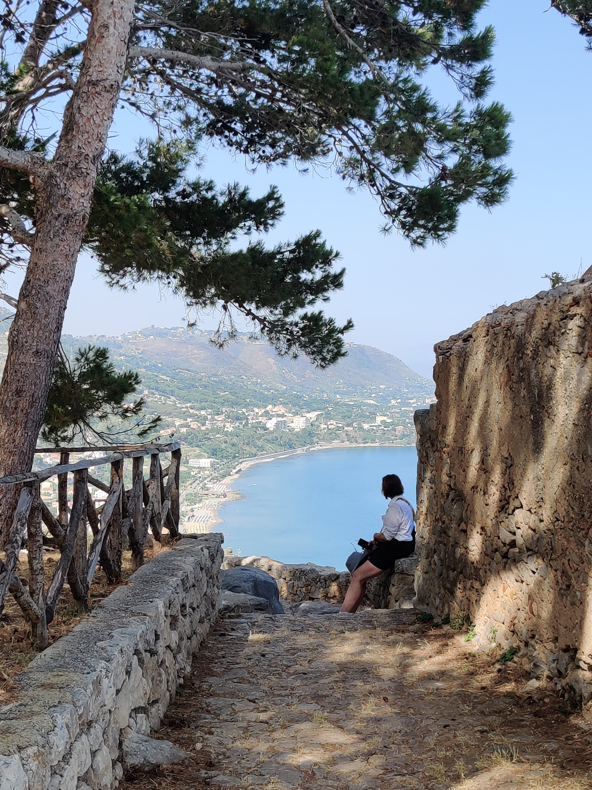

Slide 6
Neurodivergent

Slide 7


Slide 8
Data nerd

Slide 9
TOC

Slide 10
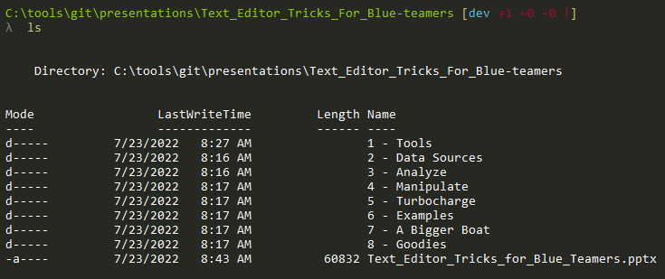

Slide 11
C:\TextEditor\Tools

Slide 12


Slide 13
Built for comfort

Slide 14


Slide 15
Built for speed

Slide 16


Slide 17
C:\TextEditor\Data

Slide 18
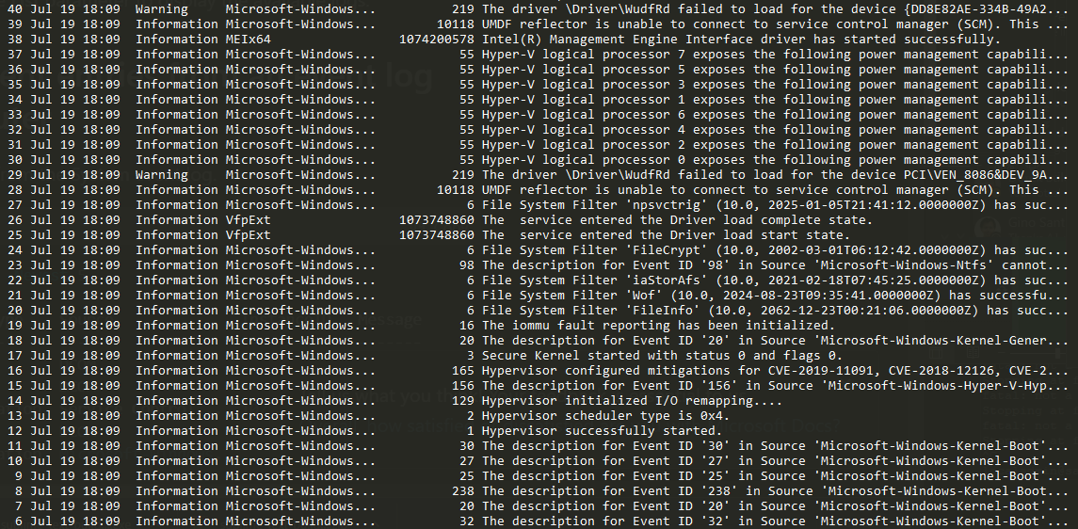
Log files

Slide 19
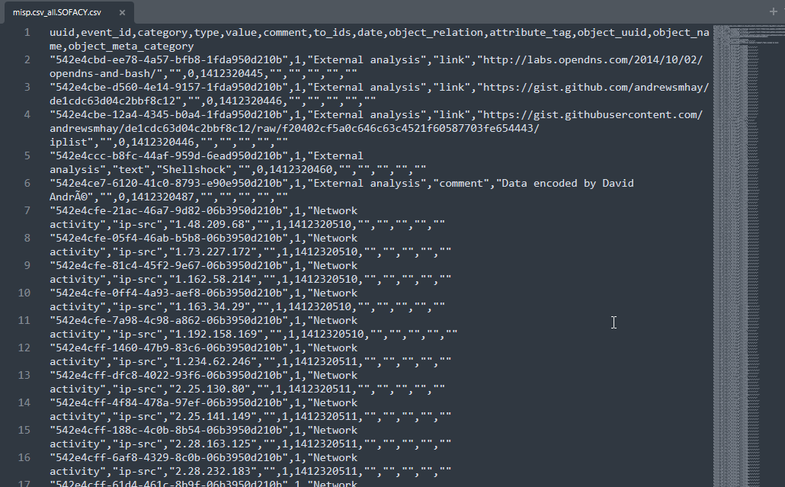
Observables / IOCs

Slide 20
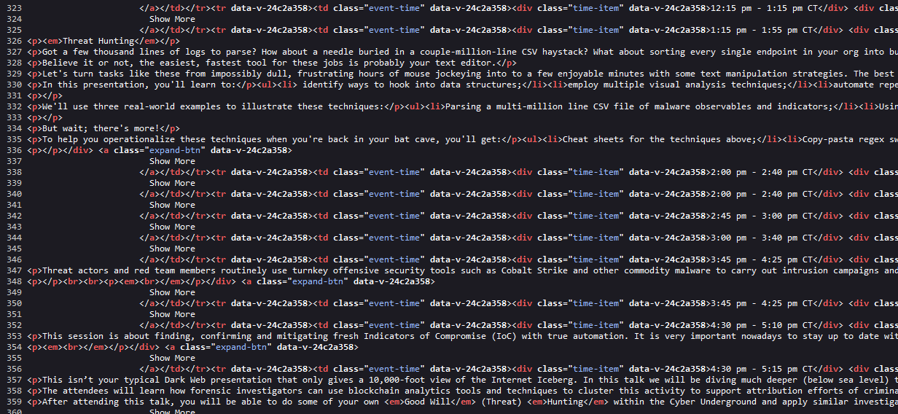
Web data

Slide 21
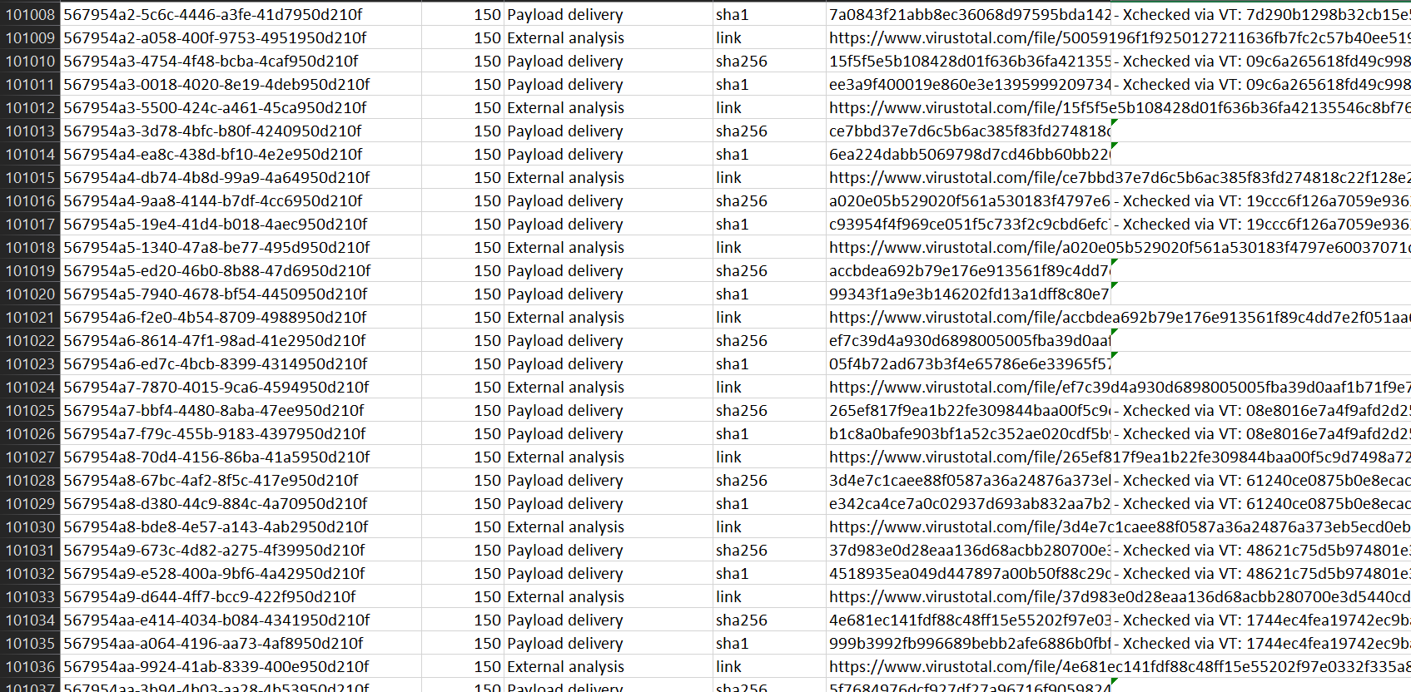
Delimited data

Slide 22
Needs to be text (obvs)

Slide 23
C:\TextEditor\Analysis

Slide 24
“Visual Analysis”

Slide 25
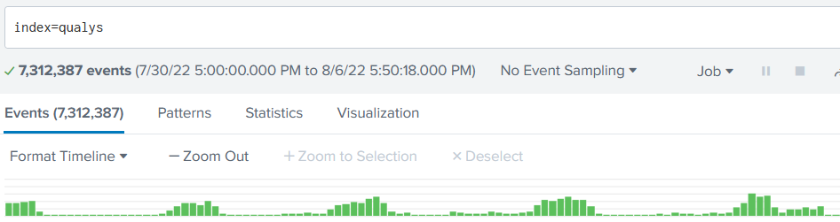
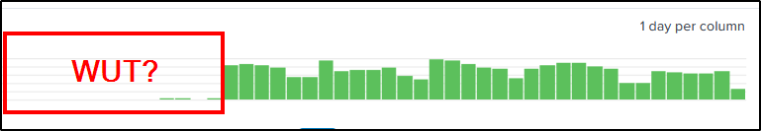

Slide 26
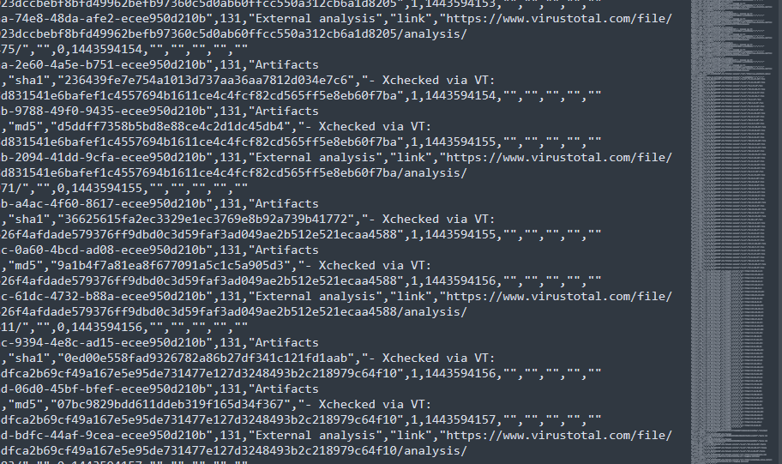

Slide 27
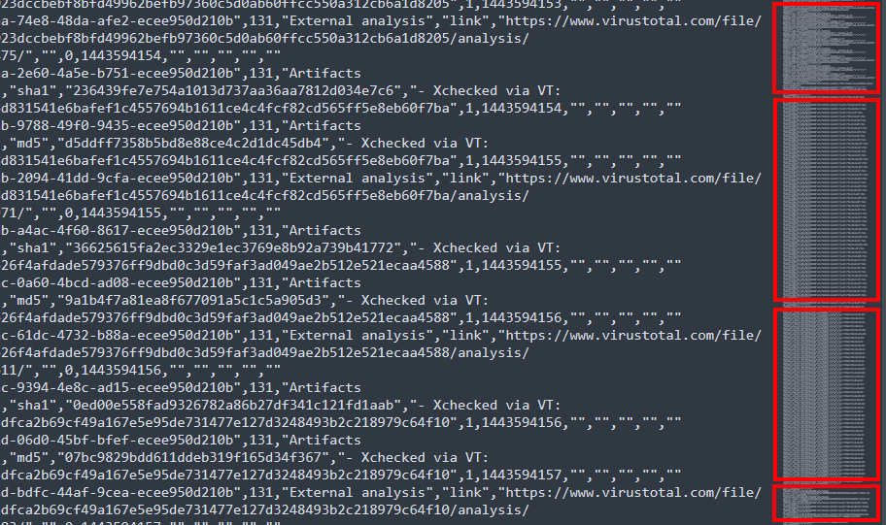

Slide 28
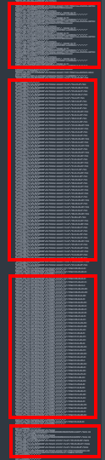
Hashes checked via VT
Destination IPs
URLs
Payload hashes

Slide 29
Pattern Analysis

Slide 30
Sorting reveals patterns

Slide 31
Patterns point to data

Slide 32
Data becomes information

Slide 33


Slide 34
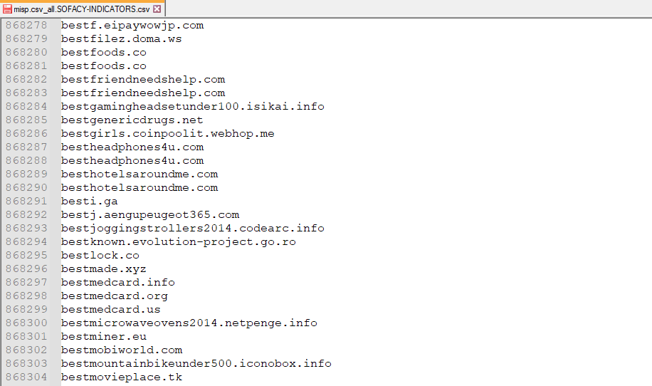

Slide 35
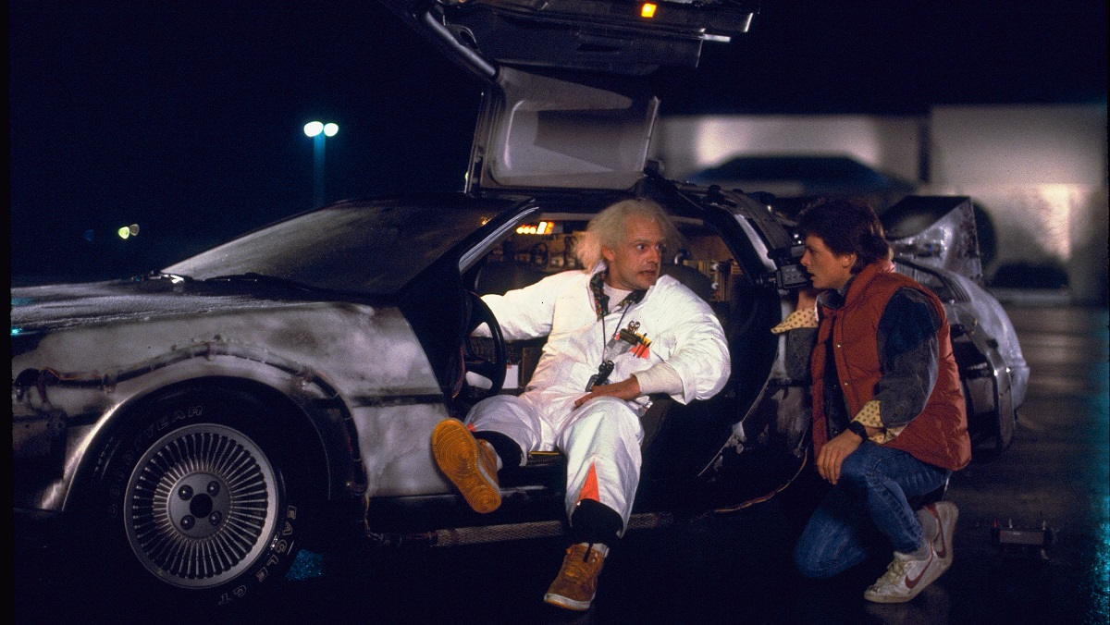

Slide 36


Slide 37


Slide 38
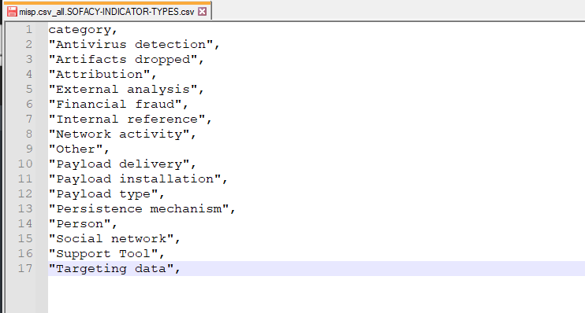

Slide 39


Slide 40
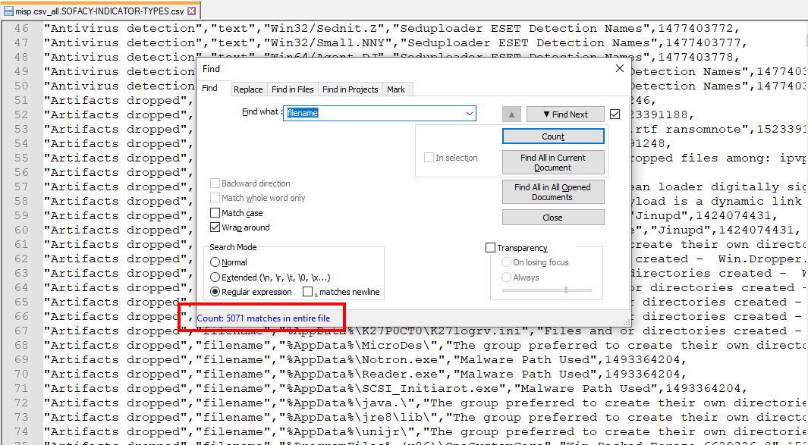

Slide 41
C:\TextEditor\Turbo

Slide 42
Amplification!

Slide 43
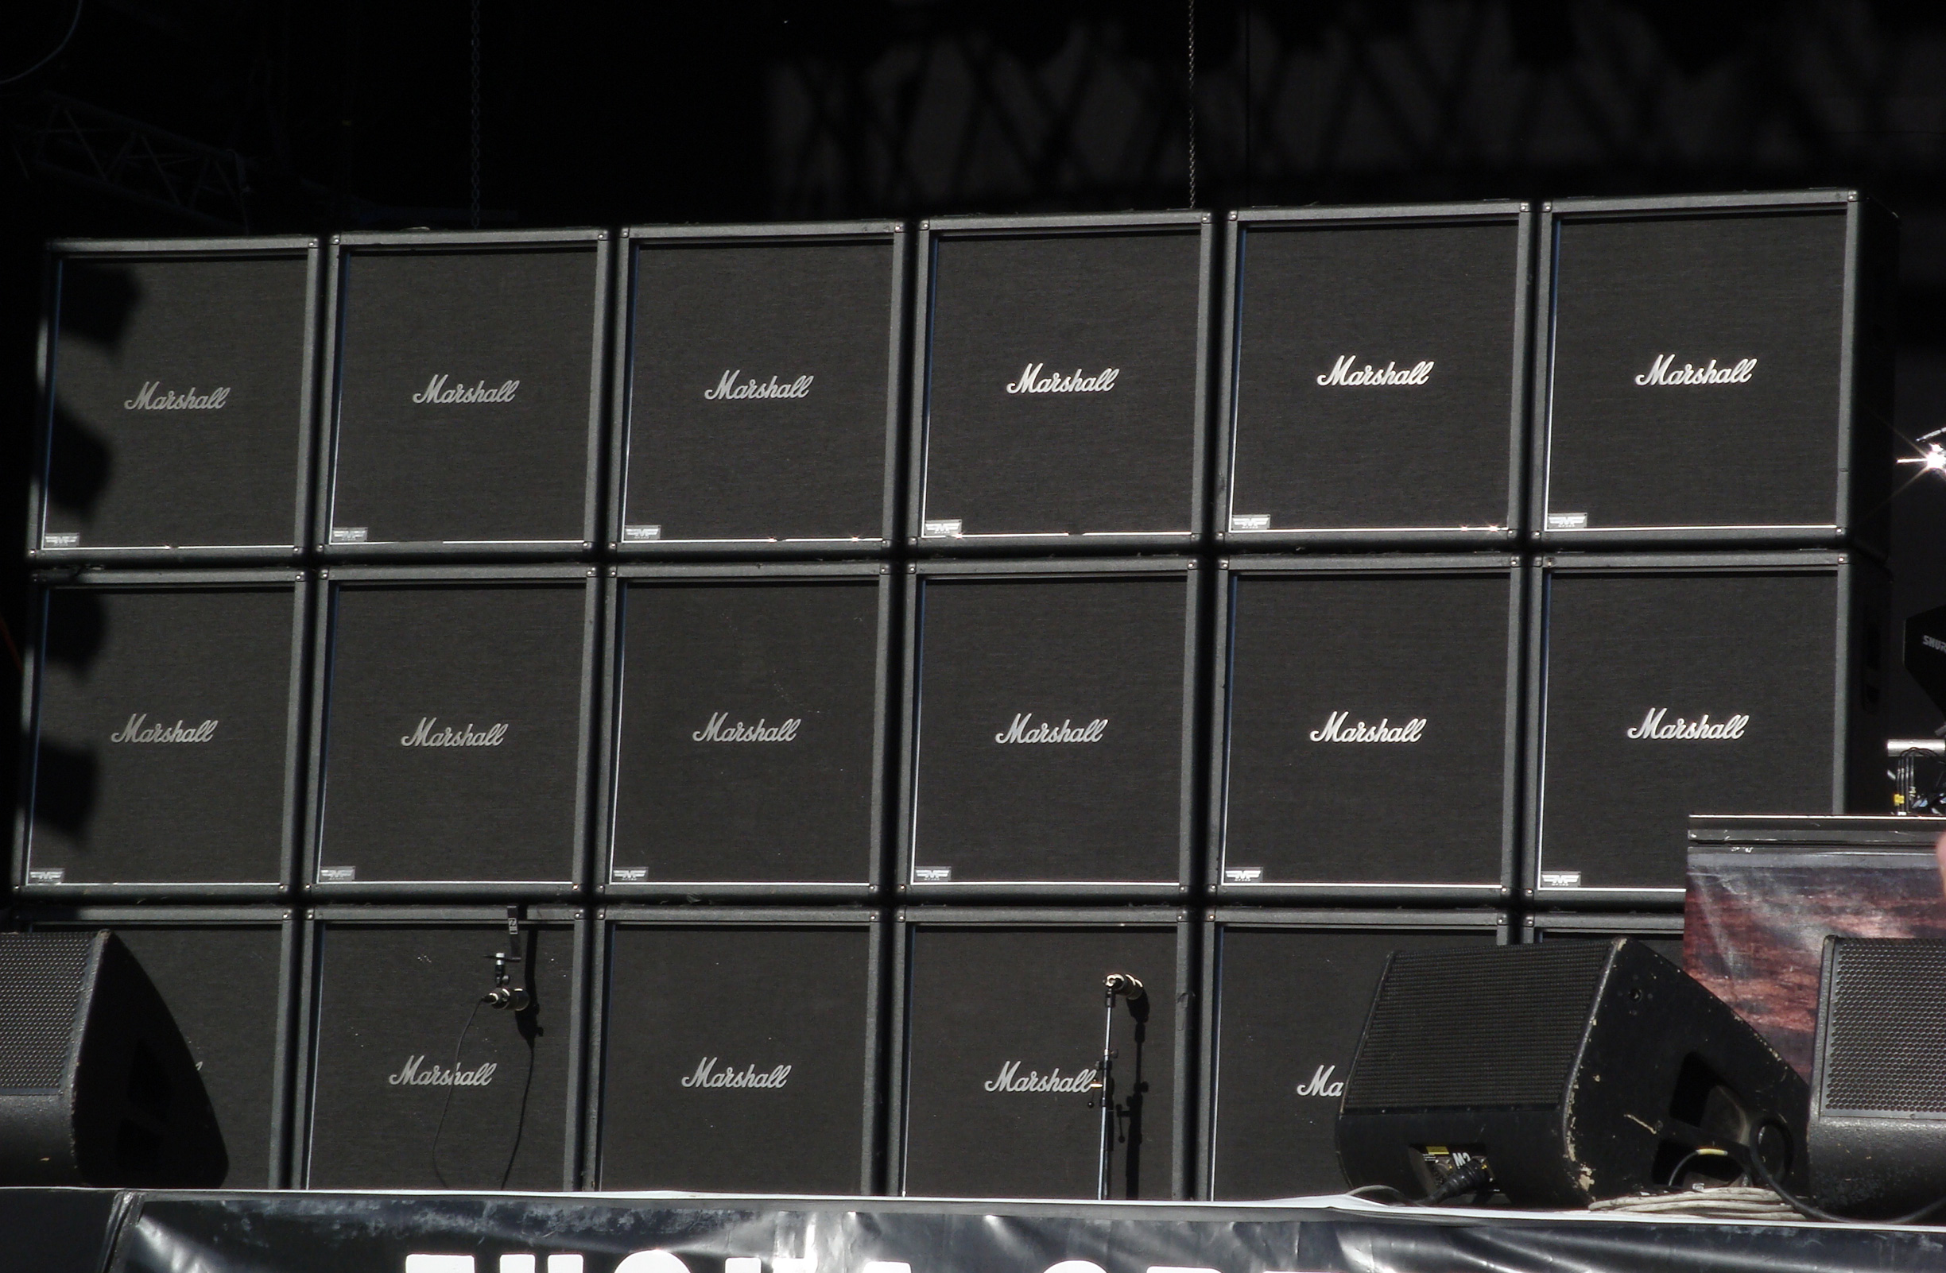

Slide 44
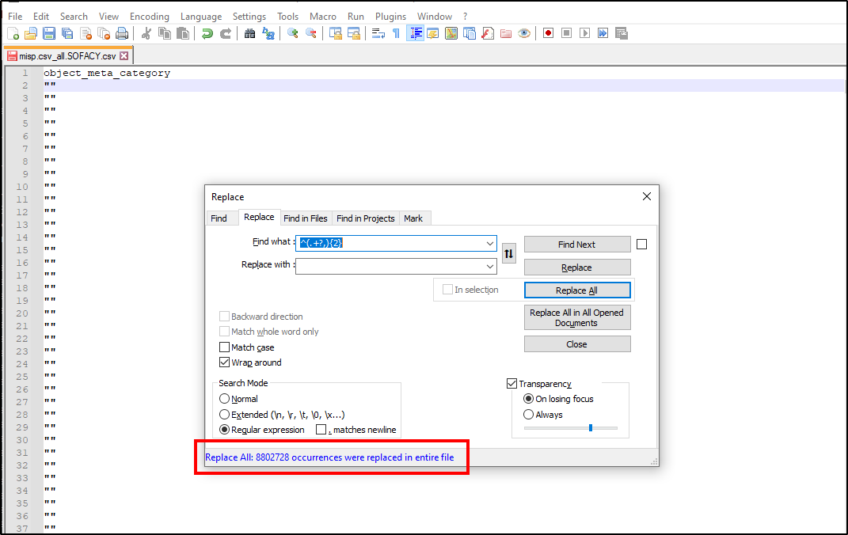

Slide 45


Slide 46
Denoizification

Slide 47
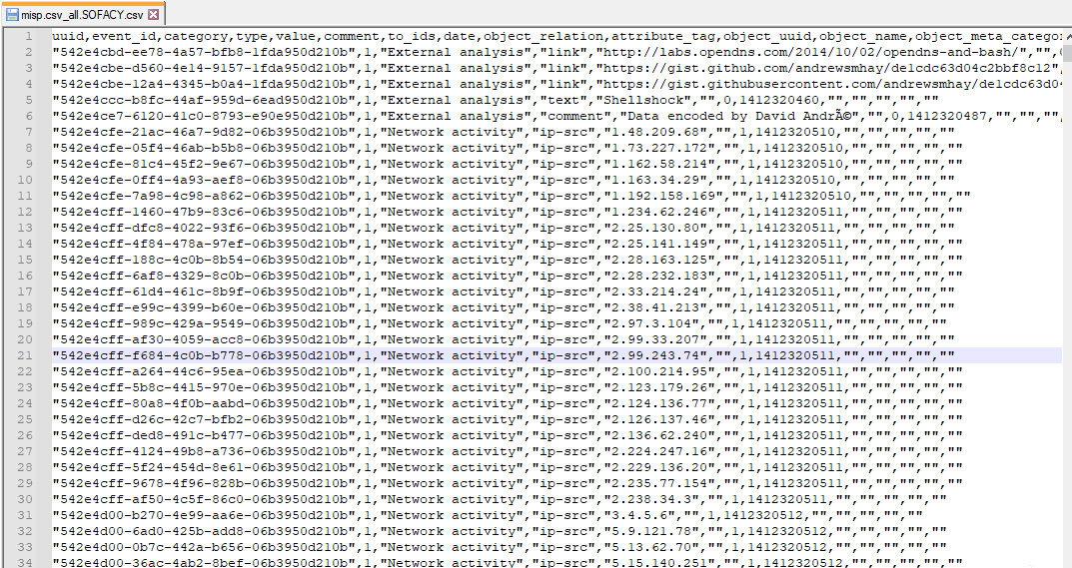

Slide 48
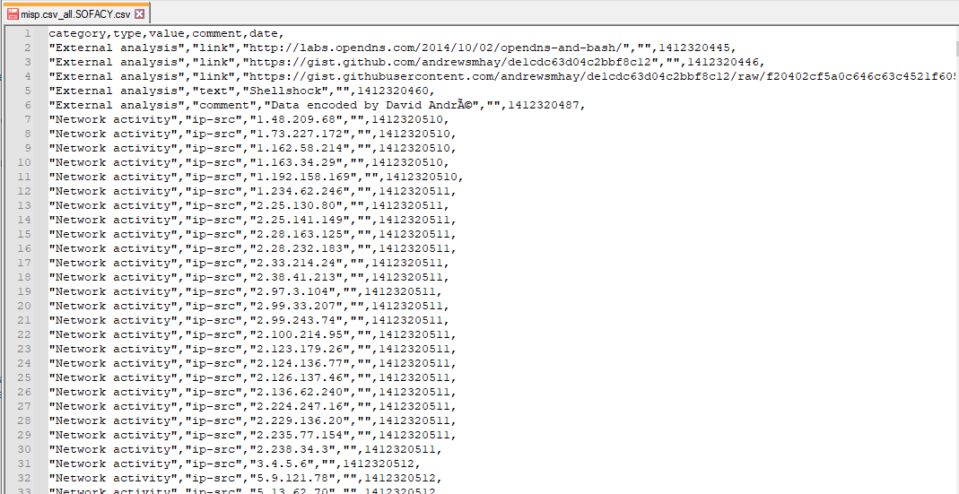

Slide 49
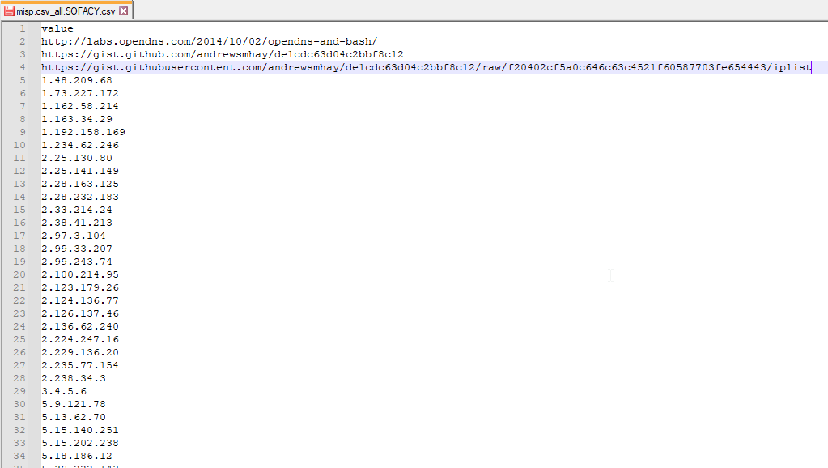

Slide 50


Slide 51
Regex <happy_sigh/>

Slide 52
Diff (two or more)

Slide 53
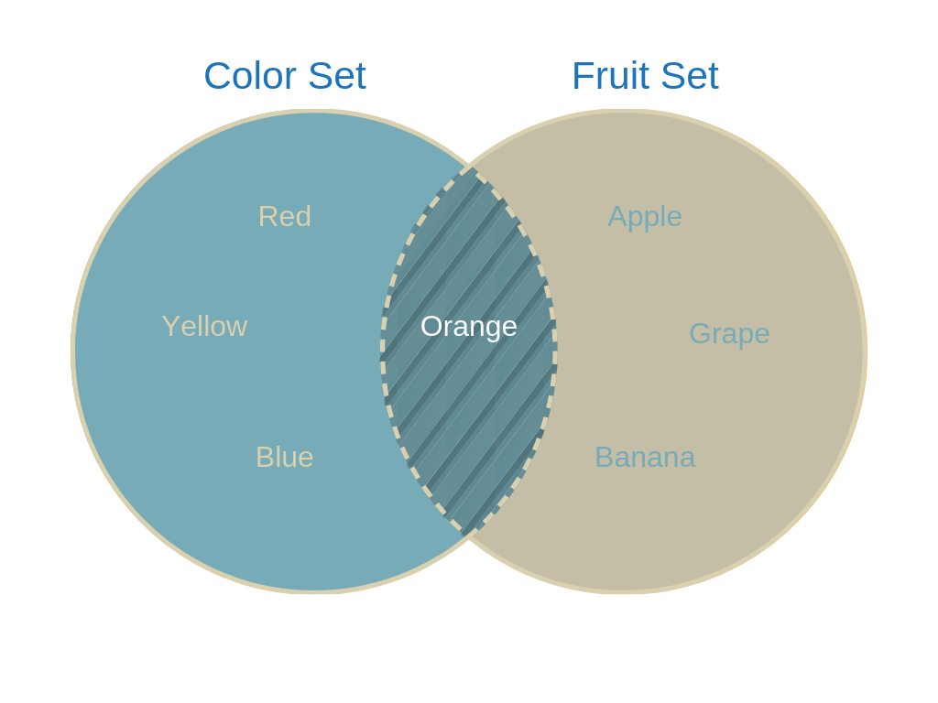

Slide 54
Scriptable patterns

Slide 55


Slide 56
C:\TextEditor\Examples

Slide 57
C:\TextEditor\TimeForOtherTools

Slide 58
Filtering

Slide 59
Data visualization

Slide 60
Pivoting

Slide 61
C:\TextEditor\Goodies

Slide 62
kthxbye

